Slide 1
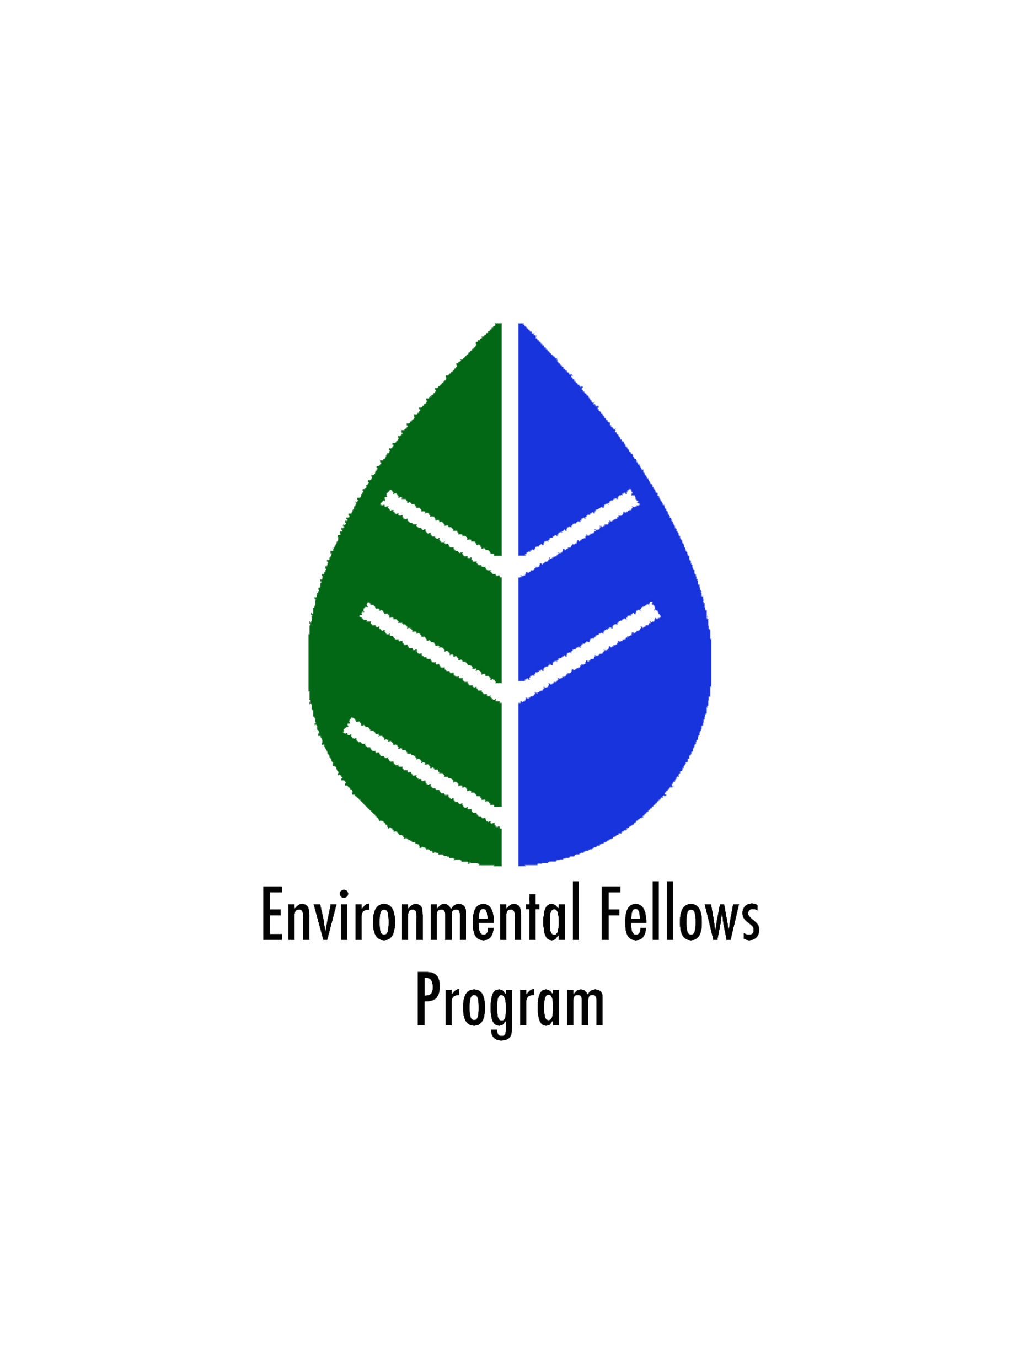
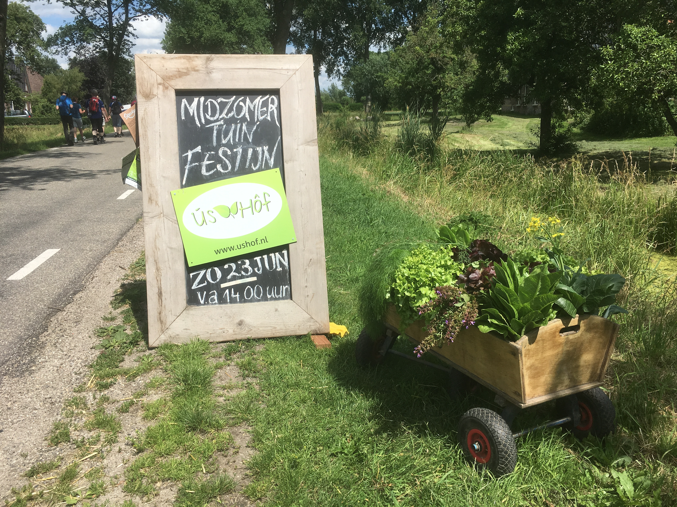
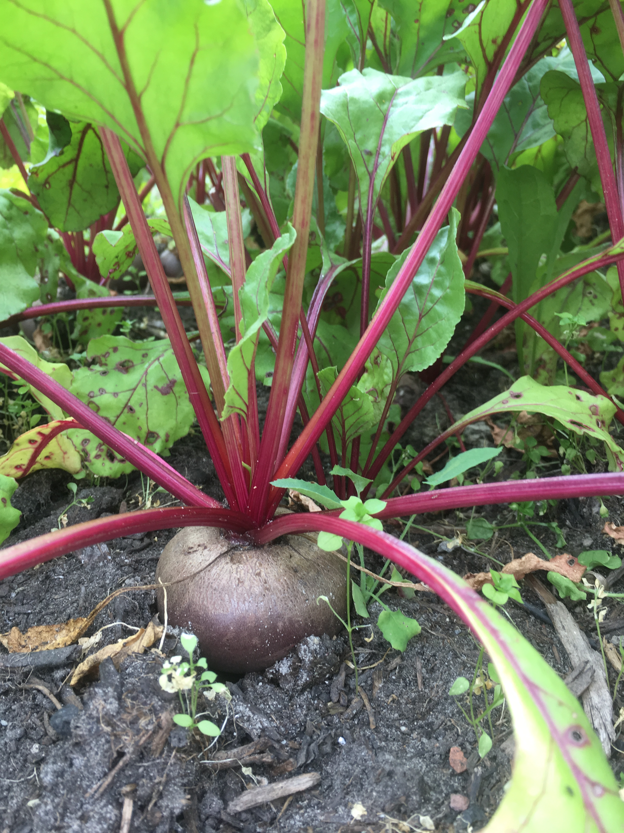
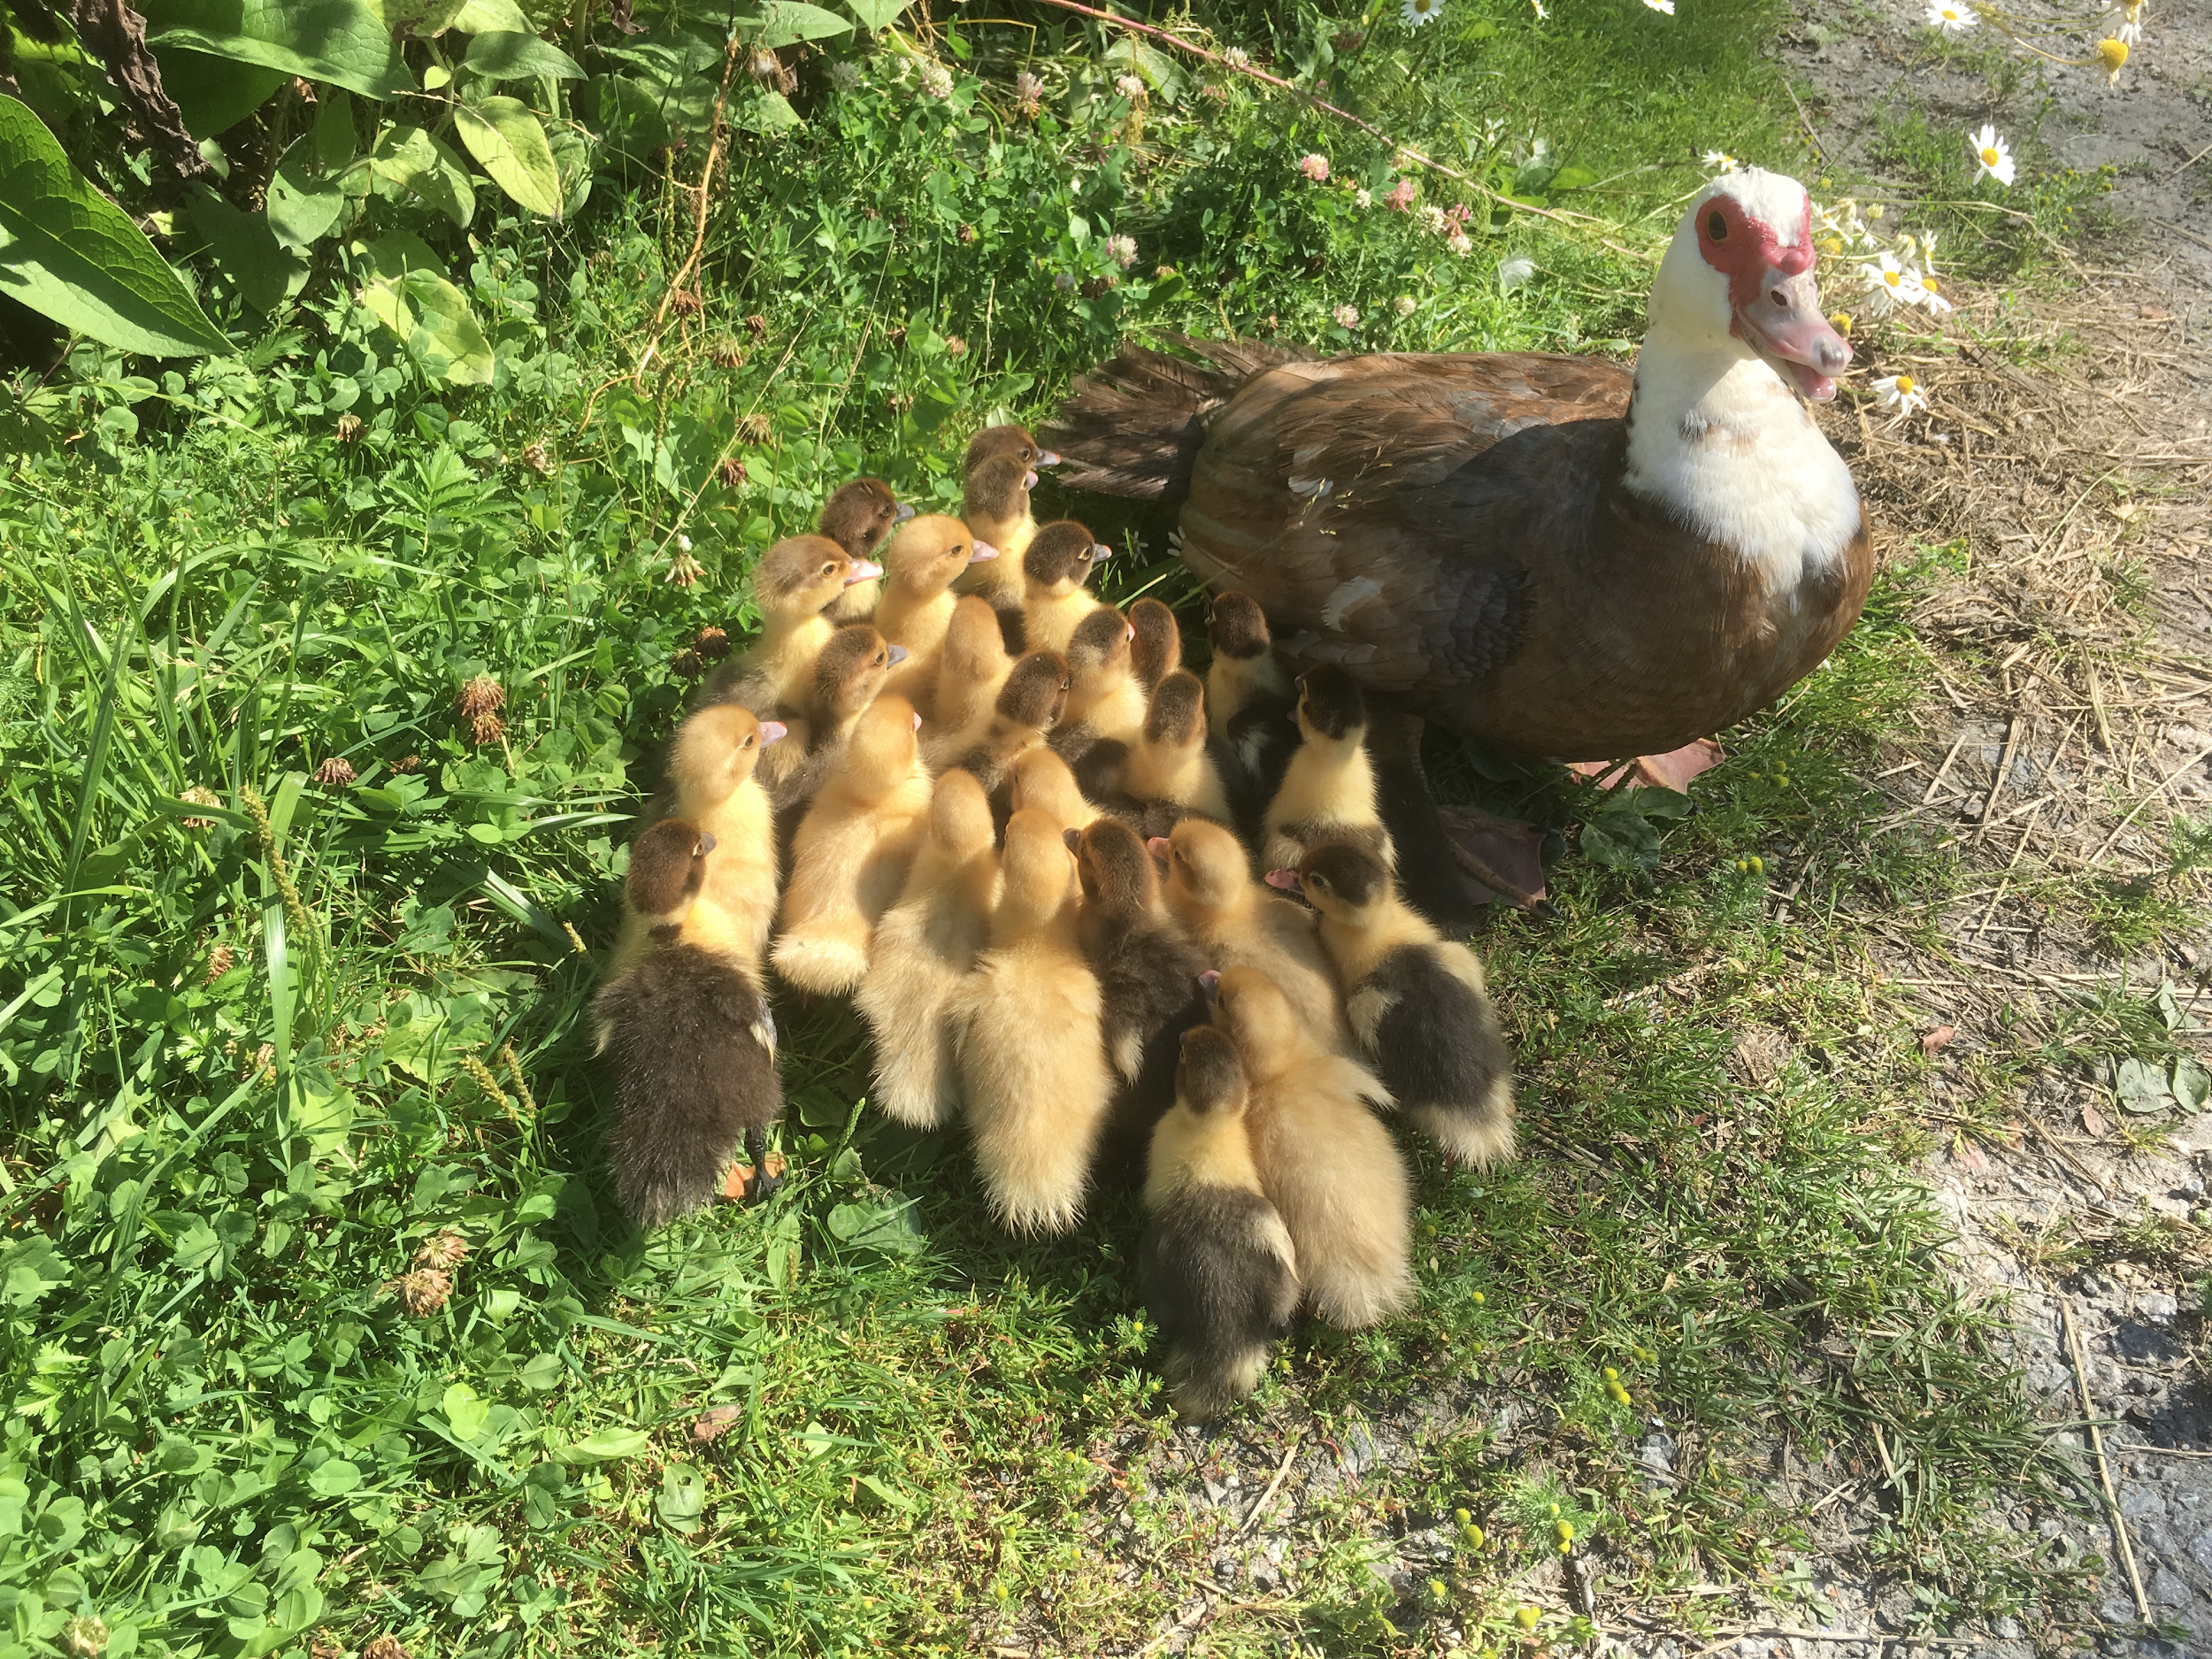
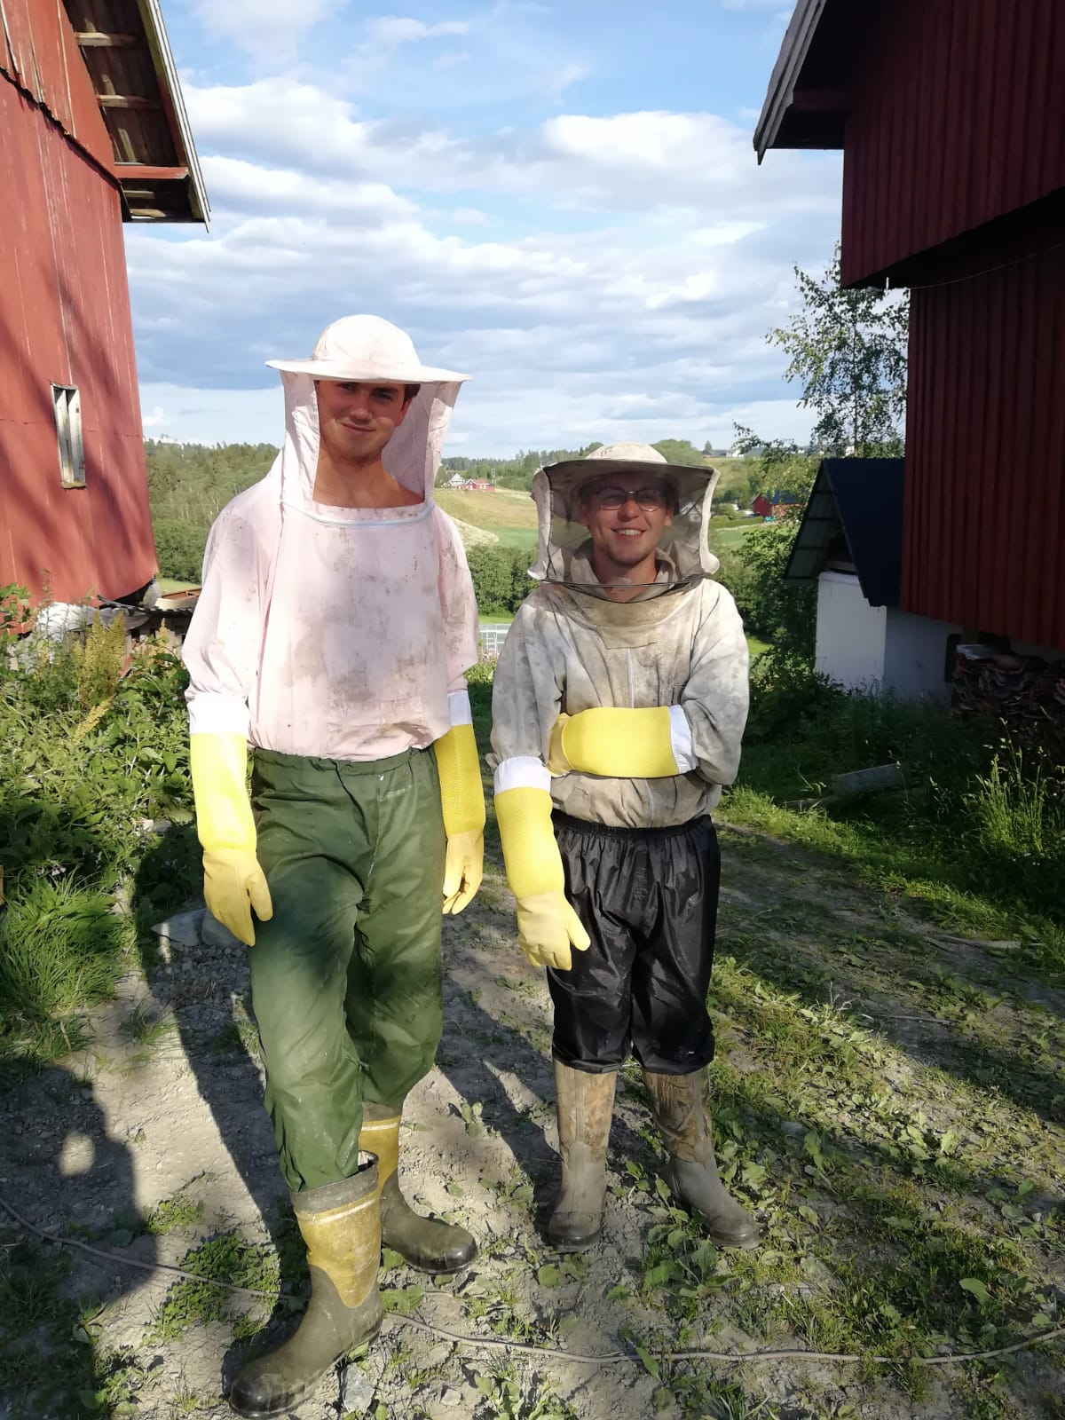
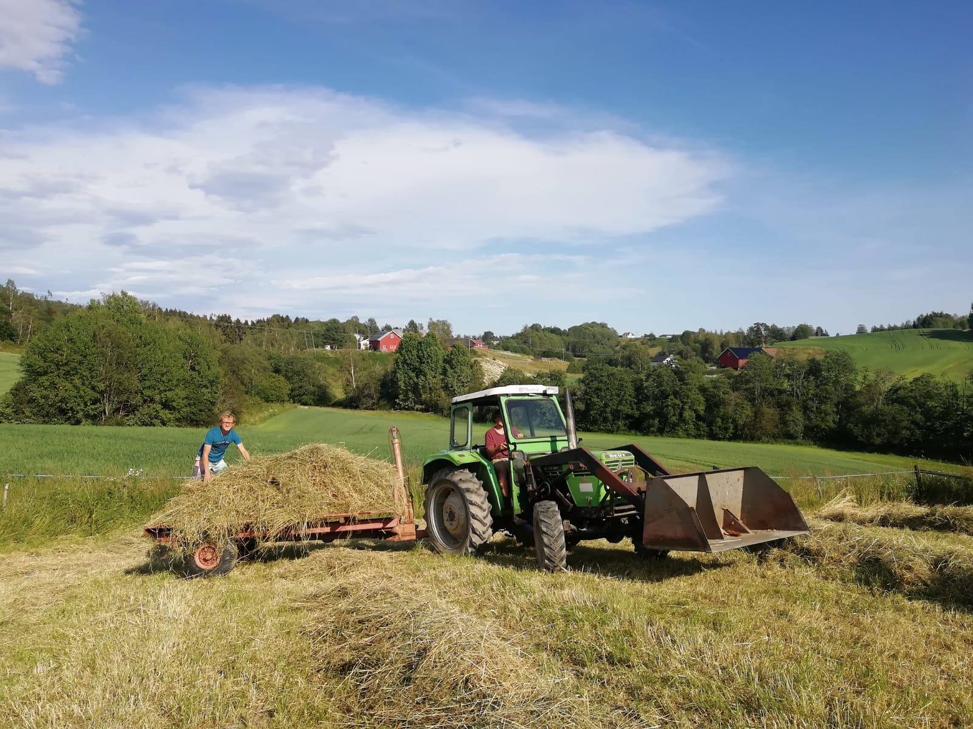
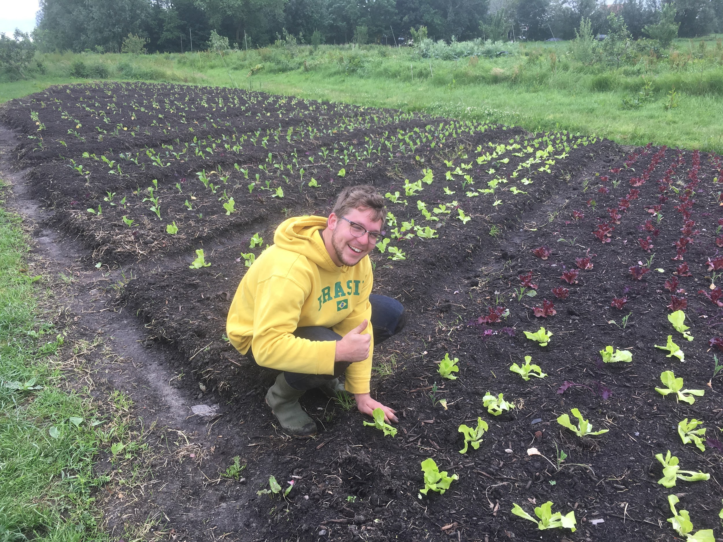
WWOOFing in northern Europe: a cross-cultural examination of food, farming, and community
Seth Brawner
ÚS HÔF FARM
INTRODUCTION
Industrial agriculture has changed the way people view food, further separating the farm and the table. While more food is available, the implementation of a large-scale food system has caused many human health issues and global environmental problems. Small-scale organic farms are not the ultimate solution, but they have the potential to combat these environmental issues while restoring local, more transparent food systems. Living and working on two farms in northern Europe helped me to understand the importance of local, small-scale agriculture and how it relates to land stewardship and community.
ARSTUN FARM
Located outside the town of Sneek in the Netherlands
Vegetable and herb farm with some fruit trees and perennial shrubs
Very organized and efficient farm and business
Self-harvest CSA with restaurant section
Harvest Festival
Unchanging daily routine
Less frequent cooking
Responsibilities included weeding, planting, trellising, pruning, and bed preparation
Located outside the city of Oslo in Norway
Small herb and vegetable farm with bees and ducks
A more holistic approach to agriculture
Small farm stand
More independence and less routine
Daily cooking with garden ingredients
Responsibilities included weeding, pruning, trellising, planting, beekeeping, duck and chicken husbandry, working with hay, and harvesting
MY GOALS
Learn the logistics of managing a small farm and business
Determine if I enjoy the agricultural lifestyle
Experience and learn from different cultures
Compare European food systems to American systems
Live at a slower pace
Cook with farm produce on a regular basis
Examine the relationship between food and community
PRACTICUM TAKEAWAYS
Through my practicum, I gained firsthand experience working on and then managing small, organic farms. I realized that I absolutely love the agricultural lifestyle and that I want to continue working in this field in my future. Living with two host families and other WWOOFers also allowed me to learn about multiple northern European cultures. While my exposure was limited, the people I met seemed to live life at a slower pace. I also learned how to cook many vegetarian-based meals using ingredients from a garden. Cooking and farming were inextricably tied to community and throughout the experience I was able to learn from people of many different backgrounds as we worked toward the common goal of growing food and feeding each other.
ACKNOWLEDGMENTS
I would like to thank Michel and Bregje for hosting me at Us Hof Farm and Erandi and Kore for hosting me at Arstun Farm. I would also like to thank my advisor, Malorie Garbe, for helping me reflect on this experience.

