Slide 1
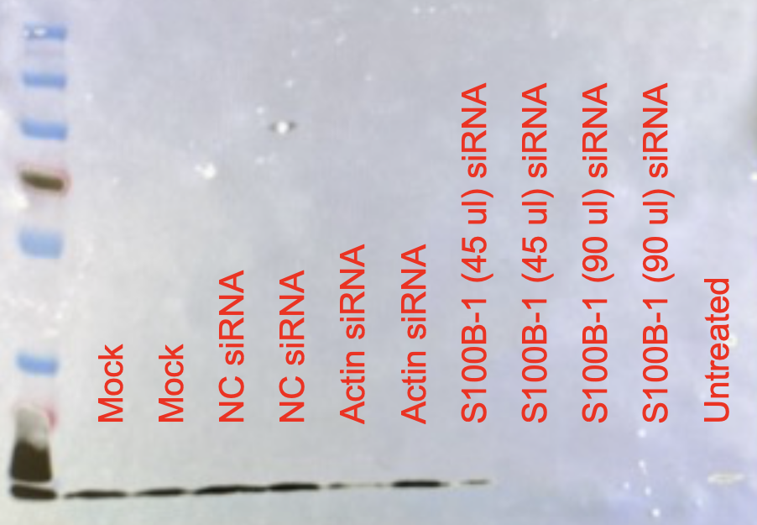
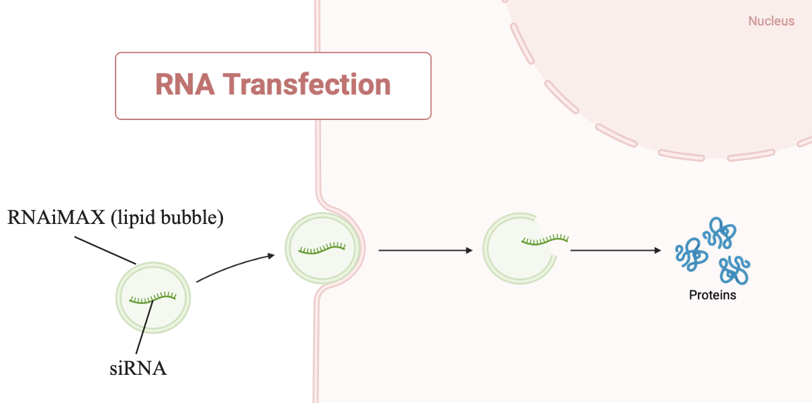
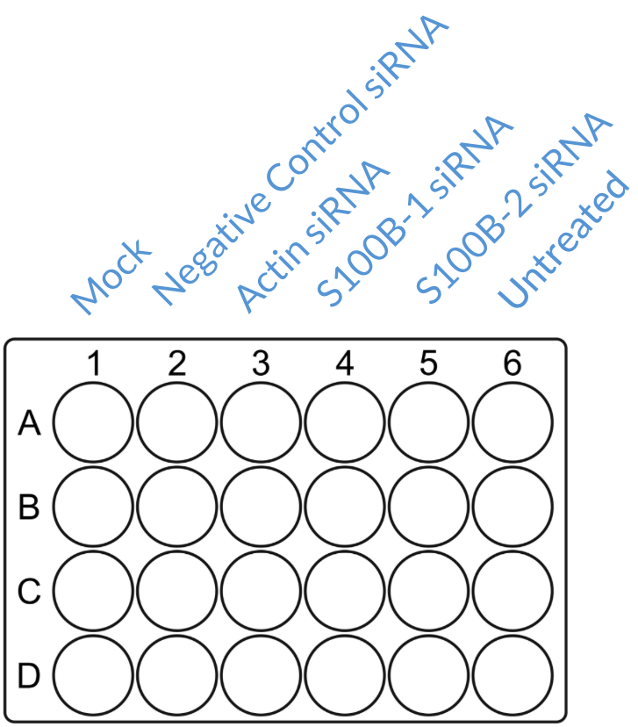
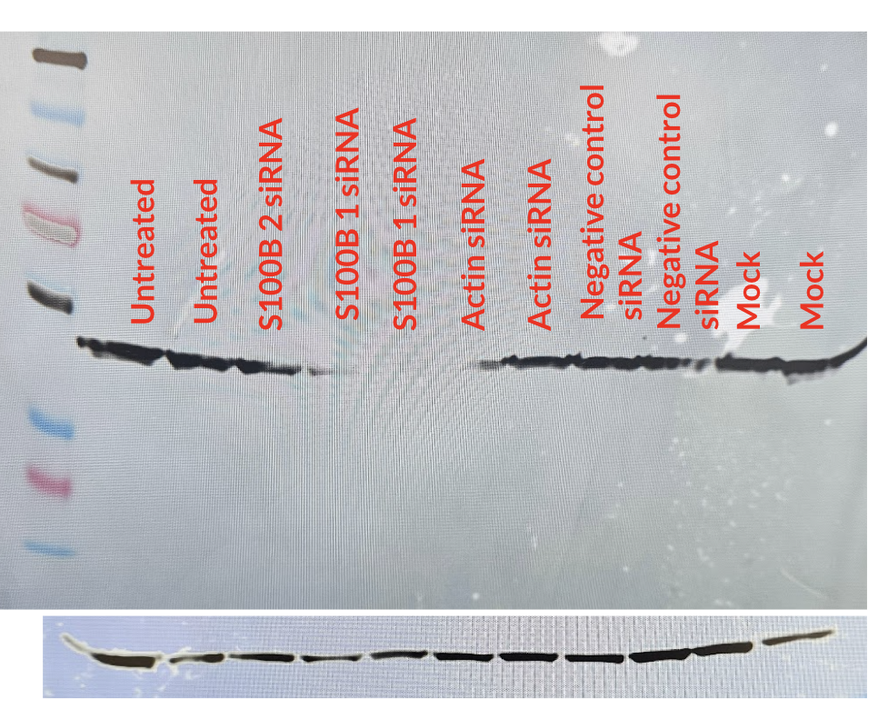
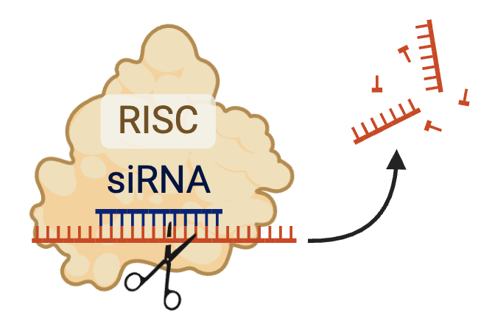
Comparison of S100β Expression in SK-MEL-25 and A-375
Department of Biology, DePauw University
Nev Hommel, Ayusha Pokharel, Dr. Nipun Chopra, PhD
Introduction
Gel Electrophoresis and Western Blot Process
Gel Imaging of SK-MEL-25 with S100β Primary Antibody
Traumatic brain injury (TBI) occurs when a blunt force contacts the head and causes damage to the brain. The most common causes of TBI are fall injuries, sports, and military injuries. Following a TBI, the protein S-100β is overexpressed in neurons. S100β is a calcium-binding protein that is important for cell growth, differentiation, and proliferation. When S100β is overexpressed, it causes cell death, via its binding to the RAGE receptor. A potential treatment to limit the expression of S100β is the usage of microRNA. MicroRNA (miRNA) is a short strand of RNA that can bind to a target mRNA and either degrade the mRNA or suppress the translation process. The ultimate goal of this research is to determine whether miR-3705 suppresses the expression of S100β. This summer, we explored the effect of siRNA on S100β protein expression in SK-MEL-25 and A-375 cells. siRNA is another process of suppressing expression of proteins, although it has a different mechanism. We used siRNA to determine which of our cell lines expressed S100B and whether our siRNA effectively silenced S100β protein. In future research, we will investigate the effects of miR-4705 – a previously identified miRNA in the Chopra lab - on S100β protein expression.
Gel electrophoresis is a process by which we separate proteins according to molecular size. The separated proteins are transferred out of the gel to the surface of a suitable membrane.
.
S100β
Actin
12 kDa
42 kDa
Methods
Figure 2: Western Blot with S100β primary antibody showing the comparison between mock, negative control siRNA (NC), actin siRNA, S100β-1 siRNA (45 ul), S100β-1 siRNA (90 ul), and untreated. We expected to see reduced expression of S100β protein in lanes with S100β-1 siRNA, which we did. However, we also saw reduced expression in the untreated lane. Thus, we could not be sure that the S100β siRNA was effective or if another unknown variable was causing the reduced expression. Furthermore, we would expect that all of the actin bands were identical. Instead, we saw that two lanes (mock and negative control) had no actin bands.
Cell Transfection
Results and Discussion
Gel Imaging of A-375 and SK-MEL-25 with S100β Primary Antibody
Figure 3: Western Blot comparing S100β in two different cell lines. The first three lanes, excluding the control ladder, were loaded with SKMEL-24 cells transfected with mock, S100β-1 siRNA(45ul), and S100β-1 siRNA(90ul), followed by the same transfection in the A-375 cell line. S100β was successfully detected in the SKMEL-25 cell line at the correct molecular weight 15KDa. The expression of S100β is significantly reduced in the SKMEL-24 cell line, suggesting that S100β-1 siRNA successfully silenced the production of s100β. However, S100β was not expressed by the A375 cell line as indicated by the absence of bands in the last three lanes.
Gel Imaging of A-375 with S100β Primary Antibody
Unknown
(45 kDa)
S100β
(15 kDa)
S100β
Actin
45 kDa
42 kDa
SK-MEL-25
A-375
Summary and Future Directions
To test if S100β would be downregulated by siRNA, A375 and SK-MEL 24 cells were transfected on a 24-well plate with four repeats of each condition.
Our plan for the summer was to experiment with whether miRNA-4705 could inhibit the production of S100β or not. The first step was to test the effectiveness of S100β siRNA in inhibiting the expression of S100β. Our transfection with S100β siRNA-1 had unforeseen complications. Unfortunately, our cell culture incubator ran out of carbon dioxide twice during the weekends, resulting in mass cell death. This unavoidable circumstance slowed down our work with the different cell lines. However, by the end of the summer, we determined that the A-375 cell line didn’t produce S100β or at least didn’t produce enough for us to experiment with. On the other hand, SK-MEL 25 produced S100β, and we were able to use S100β siRNA to inhibit the production of S100β. Therefore, S100β siRNA can be used as a positive control in future studies. The next step forward is to use SK-MEL-25 cells to determine whether miRNA-4705 can regulate the expression of S100β.
Mock | Negative control siRNA | Actin siRNA | S100B-1 siRNA | S100B-2 siRNA | Untreated
Media + Transfection complex | Media + of Transfection complex + NC siRNA | Media + Transfection complex + Actin siRNA | Media + Transfection complex + s100β-1 siRNA | Media + Transfection complex + s100β-2 siRNA | Media
Figure 1: Western Blot with S100β primary antibody showing the comparison between S100β-1 siRNA, S100β-2 siRNA, actin siRNA, and negative control siRNA. We expected to see the reduced expression of S100β in the lanes of S100β-1 and S100β-2 siRNA, which would indicate that the siRNA was successful in inhibiting the expression of siRNA and therefore, it could be used as a positive control in future experiments with miRNA. Even though we got the expected result, the molecular weight of the band observed was 45 kDa, which is very high as opposed to the expected band of S100β at 10-15 kDa. The higher molecular weight indicated that the primary antibody had shown non-specific binding to another protein.
RNAiMAX is a lipid used as a vehicle to get siRNA into the cell. Opti-MEM is media with additional nutrients and growth factors that help make transfection more efficient. NC (Negative Control) siRNA is a silencing RNA that is not known to bind to any known mammalian gene. We use it to determine whether there is nonspecific binding. Actin siRNA acts as another control and is how we determine whether transfection was successful.
Acknowledgements
Funding was provided by the Asher Fund for Student Faculty Research and Dr. Chopra's startup funding provided by Academic Affairs. We would also like to thank Macie Barker, Daniel Rhodes, and the Psychology & Neuroscience and Biology departments.

